Slide 1
AI based motion control initial version of collision detection and path replanning
12.10 Jin Lexuan

Slide 2
Path planning for 2 UAVs:
1.set priority for each UAVs
2.collision point detetion for 2 path
3.if no collision
calculate trajectory for each part
else
high priority UAV keeps original path
replan the path of the UAV with lower priority:
a. calculate the time when high priority UAV pass the collision point
b. slow down the velocity of low priority UAV, replan the path make sure it pass the collison point when high priority UAV passed
c. calculate trajectory for new path

Slide 3
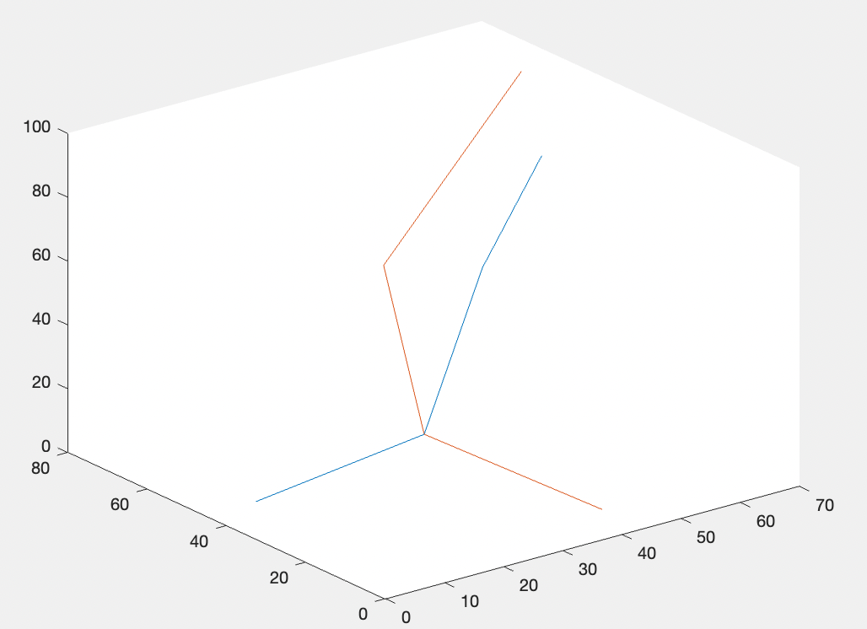
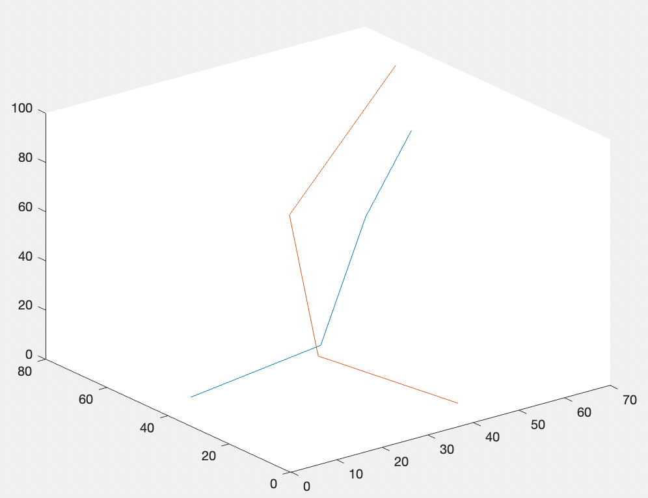
Original path and replanned path

Slide 4
Future work
Now is an initial verison, collision point detection part is not finished
Two path is set manually now,in the future this method will combine with the path generated from the path planning algorithm
This method will be adjusted to any two path
After finishing above, it will be applied for more than two UAVs

